Slide 1
Data Repeater Control

Slide 2
Content
Introduction to DataRepeater Control
Adding Properties to Control
Setting the Procedure Attributes
Connecting the Database With ADO
Connecting the ADO With DataRepeaterControl

Slide 3
Introduction to Data Repeater Control
The data repeater is specifically designed for use with ADO.
Essentially the data repeater control acts as a data-bound container for any user control you create.
At run time, the data repeater displays several instances of the user control - each in its own row.

Slide 4
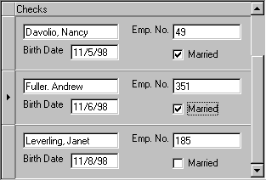
Example:
User control is designed to show one record of an employee database.

Slide 5
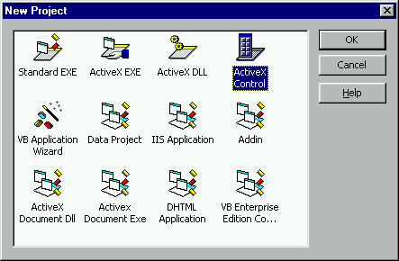
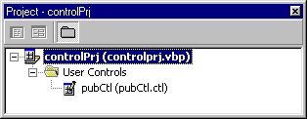
Working with Data Repeater Control Step 1
Creating an ActiveX Control to Work with the Data Repeater.

Slide 6
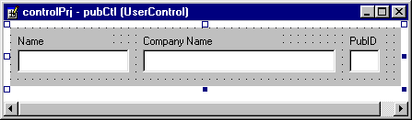
Step2
Draw the controls.
Control | Name property
Text1 | txtName
Text2 | txtCompany
Text3 | txtPubID

Slide 7
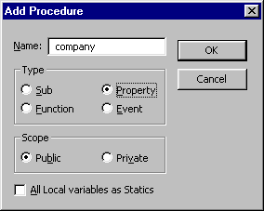
Step 3 Adding Properties to Control
From the main VB menu, select Tools → Add Procedure.
Add Procedure window will open.
Add three new public properties called company, name and id

Slide 8
Methods
Get ProductName()
Let ProductName(ByVal newProductName As String)
Example:-
Public Property Get Name() As String
Name = txtName.Text
End Property
Public Property Let Name(ByVal newName As String)
txtName.Text = newName
End Property

Slide 9
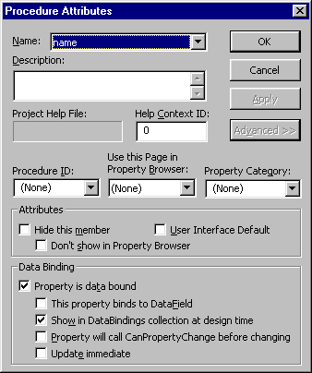
Step 4 Setting the Procedure Attributes
From the main VB menu, click on Tools → Procedure Attributes.
The names of the three properties we added will be in the Name
drop-down box.
Click on name and then click the Advanced>> button to expose the rest of the dialog box.
For the name, check the Property is data bound in the Data Binding frame.
Then check Show in DataBindings collection at design time.
Click Apply to make the changes.

Slide 10
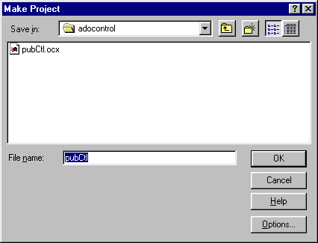
Step 5
From the main VB menu, click File → Make and name the control
It will create the .OCX file.

Slide 11
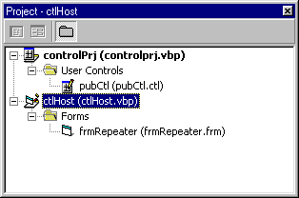
Step 6
From the main menu, select File→Add Project. Select a Standard EXE project.

Slide 12
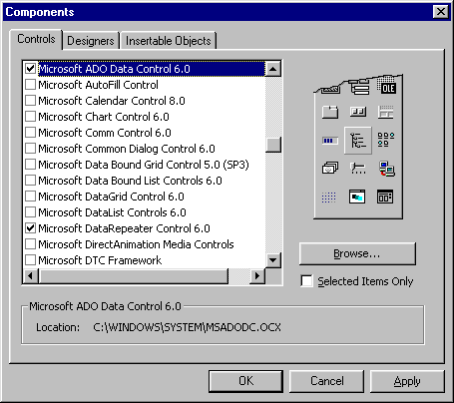
Step 7
Add the the Microsoft DataRepeater Control 6.0 and the Microsoft ADO Data Control 6.0.
The data repeater control icon looks like this:

Slide 13
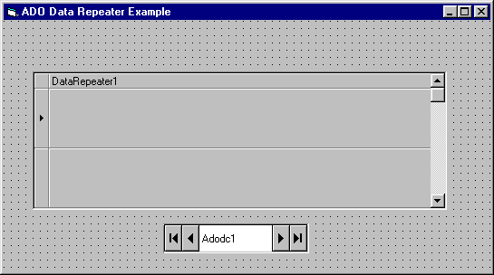
Step 7
Draw both the controls on form.

Slide 14
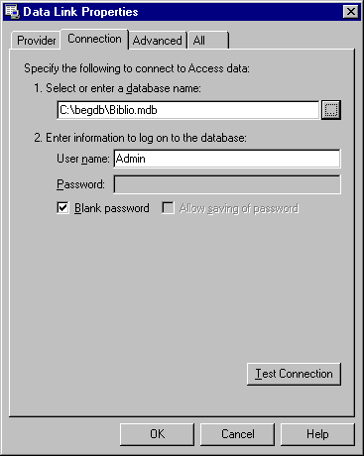
Step 8 Connecting the Database With ADO
Connect the ADO data control to the XXX.mdb database and select the YYY table.

Slide 15
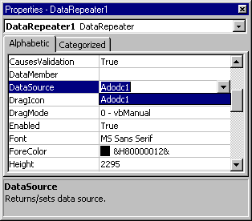
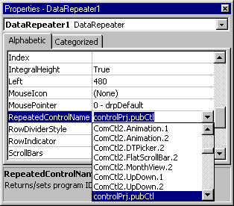
Step: 9 Connecting the ADO With Data Repeater Control
Set the DataSource property to Adodc1.
Bind our user control properties to the ADO data control.

Slide 16
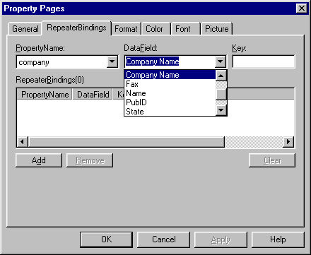
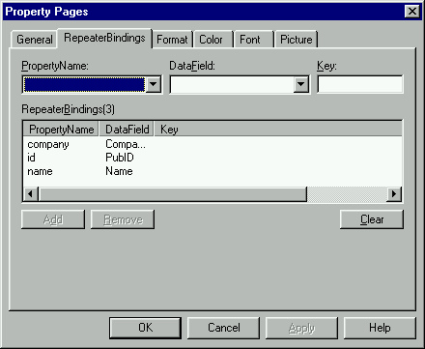
Step10
Right-click on the data repeater control and select Properties.
Click on the RepeaterBindings tab.

Slide 17
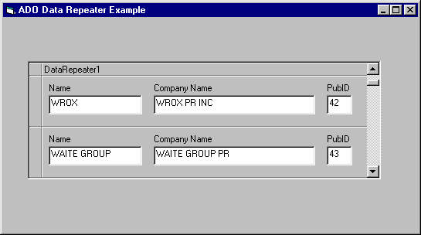
Step 11
Save your project group and press F5 to run your new data control.
Use the scroll bar to navigate the recordset.
OUTPUT

Slide 18
Image combo box

Slide 19
An ImageCombo control is similar to a standard Windows combo box control, with some important differences.
The most visible difference is the ability to include pictures in this Image combo control.
The ImageCombo control contains a collection of ComboItem objects.
It makes easier for the user to identify and choose
items from a list of possible selections.
With an ImageCombo control, we can display a list of items that includes pictures.

Slide 21
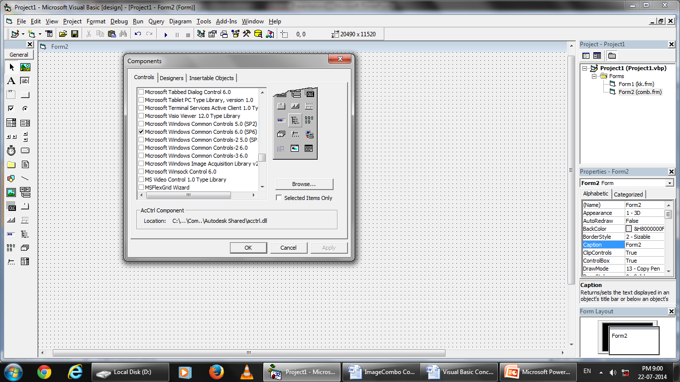

Slide 22
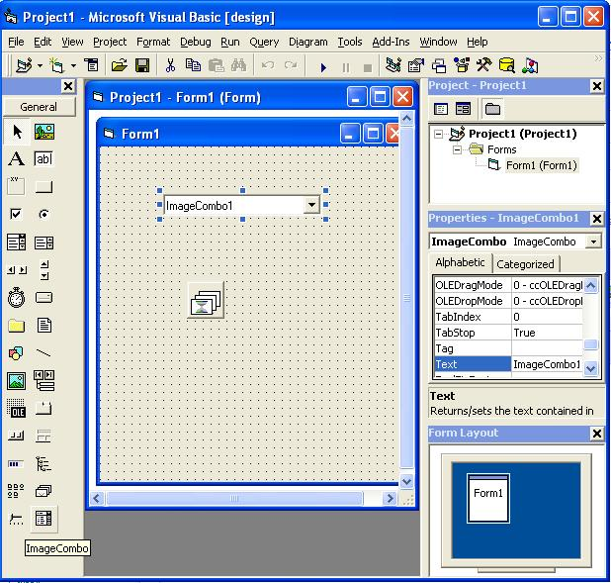

Slide 23
To manage the images used for the list items, the ImageCombo uses the ImageList common control.
Images are assigned to items in the ImageCombo through an index or key value that references a picture stored in the ImageList control

Slide 24
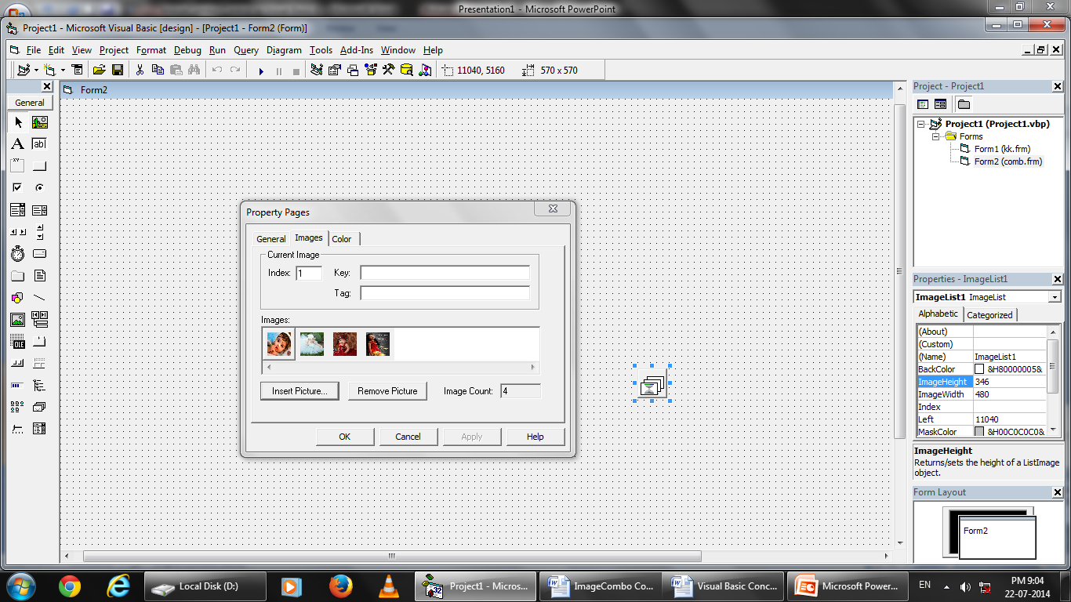

Slide 25
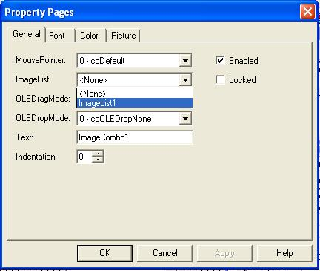
To associate an ImageList control with the ImageCombo control at run time, simply set the ImageList property to the name of the ImageList control,

Slide 26
Private Sub Form_Load()
ImageCombo1.ComboItems.Add 1, "key1", "item1", 1
ImageCombo1.ComboItems.Add 2, "key2", "item2", 2
ImageCombo1.ComboItems.Add 3, "key3", "item3", 3
ImageCombo1.ComboItems.Add 4, "key4", "item4", 4
End Sub
The following code adds a new item to the top of the list in an ImageCombo, as indicated by the supplied Index value of 1.
The new item appears in the control as “item1," as specified in the object's Text property. The image is named as“item1.“

Slide 27
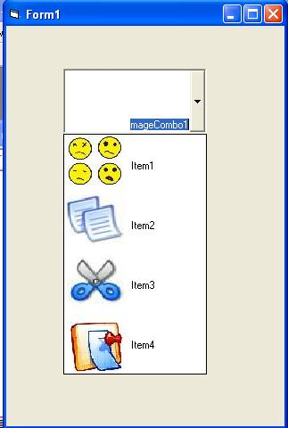
OUTPUT:

